Slide 1
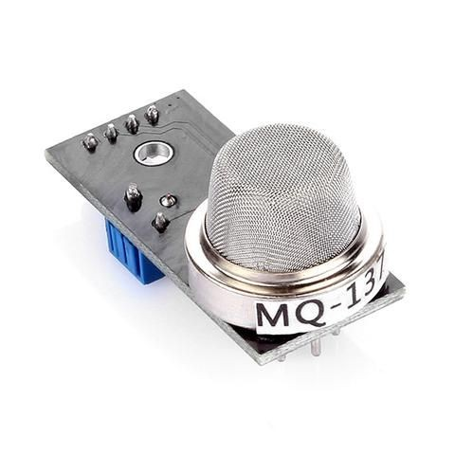
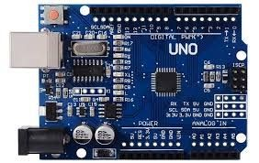
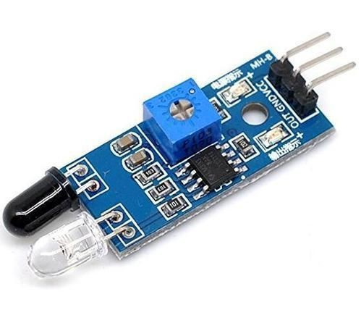
COMPONENT LIST
MQ-135 AIR QUALITY SENSOR(detects NH3 in air)
ARDUINO UNO
IR SENSOR
16*2 CHARACTER LED DISPLAY
BREADBOARD

Slide 2
MODEL WORKING
MQ-135 GAS SENSOR attached to Arduino detects the ammonia level present in the air and displays the ammonia level in ppm on the LED display.
IF ammonia level is more than 1.5 ppm then green led is switched on indicating to start the fan
IF ammonia level is greater than 2.5 ppm then red led is switched on giving an indication to clean the toilet because the smell is unbearable.
Also,if a person enters and leaves the toilet the usage count is detected by IR sensor and is incremented by one.

Slide 3
CODE
/*
* Program to measure gas in ppm using MQ sensor
* Dated: 03-03-2019
*/
#include<LiquidCrystal.h>
#define RL 20 //The value of resistor RL is 47K
#define m -0.263 //Enter calculated Slope
#define b 0.42 //Enter calculated intercept
#define Ro 76.63 //Enter found Ro value
#define MQ_sensor A0 //Sensor is connected to A4
int avg_value,n=0;
int fan=7,clean=8,ir=10;
int count=0;
int cnt=20;
LiquidCrystal lcd(12,11,5,4,3,2);
void setup()

Slide 4
{
pinMode(fan, OUTPUT);
pinMode(clean, OUTPUT);
pinMode(ir,INPUT);
Serial.begin(9600); // sets the serial port to 9600
Serial.println("NH3 in PPM"); //Display a intro message
//delay(2000); //Wait for display to show info
analogWrite(6,cnt);
lcd.begin(16,2);
}
void loop()
{
// count person with ir sensor
if(!(digitalRead(ir)))
{
count++;
Serial.print("Count=");
Serial.println(count);
Serial.print("Total=");
Serial.println(count/2);
digitalWrite(LED_BUILTIN, HIGH);
delay(1000);
}

Slide 5
//ppm levels check with MQ-135 and controlling fan, clean msg float VRL; //Voltage drop across the MQ sensor
float Rs; //Sensor resistance at gas concentration float ratio; //Define variable for ratio
VRL = analogRead(MQ_sensor)*(5.0/1023.0); //Measure the voltage drop and convert to 0-5V Rs = ((5.0*RL)/VRL)-RL; //Use formula to get Rs value
ratio = Rs/Ro; // find ratio Rs/Ro
float ppm = pow(10, ((log10(ratio)-b)/m)); //use formula to calculate ppm Serial.print("NH3 (ppm) = ");
Serial.println(ppm);
//Serial.print("Voltage = "); //Display a intro message
//Serial.println(VRL); if(ppm>2.0 && n!=2)
{
n=2;
digitalWrite(fan, HIGH); digitalWrite(clean, HIGH);
}
else if(ppm>1.2)
{
n=1;
digitalWrite(fan, HIGH); digitalWrite(clean, LOW);
}
else

Slide 6
{
n=0;
digitalWrite(fan, LOW);
digitalWrite(clean, LOW);
}
//lcd printing
lcd.setCursor(0,0);
lcd.print(String("Count=")+String(count/2));
//lcd.print(count/2);
lcd.setCursor(0,1);
lcd.print(String("NH3 ppm=")+String(ppm));
//lcd.print(ppm);
}

Slide 7
DEVICE OUTPUT
❏ Device performs various tasks based on the ammonia level present in the restroom as follows
DETECTED AMMONIA LEVEL IN PPM | TASK PERFORMED
0 - 1.5 | No Significant Smell(No task performed)
1.5 - 2.5 | Bearable Smell (Put fan on)
2.5 and above | Unbearable smell (Clean toilet urgently)
❏ IR sensor increments the person count by one when a person enters and leaves the restroom.Thus,track of toilet usage is monitered .

Slide 8
Thank You!

